Slide 1

Decision Trees & Ensemble Concept

Slide 2




What is a Decision Tree?
A decision tree is a tree-structured model that uses a series of decision rules to make predictions. At each internal node, the tree evaluates a feature and splits the data based on a condition. These splits continue until reaching leaf nodes, where the final output or prediction is produced. Think of it like a flowchart that asks yes/no questions to reach a conclusion.
Root Node
Internal Nodes
Starting point where the first decision is made
Decision points that split data based on feature conditions
Branches
Leaf Nodes
Paths representing different outcomes of decisions
Terminal points that provide the final prediction or classification

Slide 3
How Decision Trees Make Decisions
The Splitting Process
At each node, the algorithm examines all possible ways to split the data based on features. It evaluates each potential split using a purity measure like Gini impurity or information gain.
The algorithm greedily selects the split that creates the most homogeneous groups—the one that best separates different classes or reduces variance in the target variable.
01
02
Evaluate All Features
Measure Purity Gain
Consider every possible split point for each feature in the dataset
Calculate how much each split improves class separation or reduces variance
03
04
Choose Best Split
Repeat Recursively
Select the feature and threshold that maximizes purity increase
Apply the same process to each resulting branch until stopping criteria are met

Slide 4
Limitations of Decision Trees
Overfitting Risk
Learning Noise
High Variance
When trees grow too deep, they memorize training data rather than learning general patterns. Each additional split captures more specific details, including random noise that won't help with new data.
Deep trees create overly complex decision boundaries that fit every quirk in the training set. This means the model performs brilliantly on training data but fails to generalize to unseen examples.
Small changes in training data can produce dramatically different trees. This instability makes single decision trees unreliable—what works for one sample might fail on another similar dataset.

Slide 5


Bias and Variance Perspective
Decision trees exhibit an important characteristic in the bias-variance tradeoff: they typically have low bias but high variance.
Low bias means they can model complex, non-linear patterns effectively. However, high variance means they're sensitive to the specific training data—a slight change in the dataset can produce a completely different tree structure.
This variance causes instability and makes individual trees prone to overfitting. The model might perform excellently on training data but struggle with real-world predictions.
15%
85%
Low Bias
High Variance
Trees can capture complex patterns in data
Predictions vary significantly with data changes

Slide 6
What Is Ensemble Learning?
Ensemble learning is a powerful machine learning technique that combines multiple models to produce a single, more accurate prediction. Instead of relying on one model's judgment, ensembles leverage the collective wisdom of many models working together.
1
2
3
Train Multiple Models
Generate Individual Predictions
Combine Results
Create several base models, each learning from the data in slightly different ways or from different subsets
Aggregate all predictions into one final output that's typically more accurate than any single model
Each model makes its own independent prediction based on its learned patterns
This approach improves overall performance by reducing the impact of individual model weaknesses and leveraging their collective strengths.

Slide 7
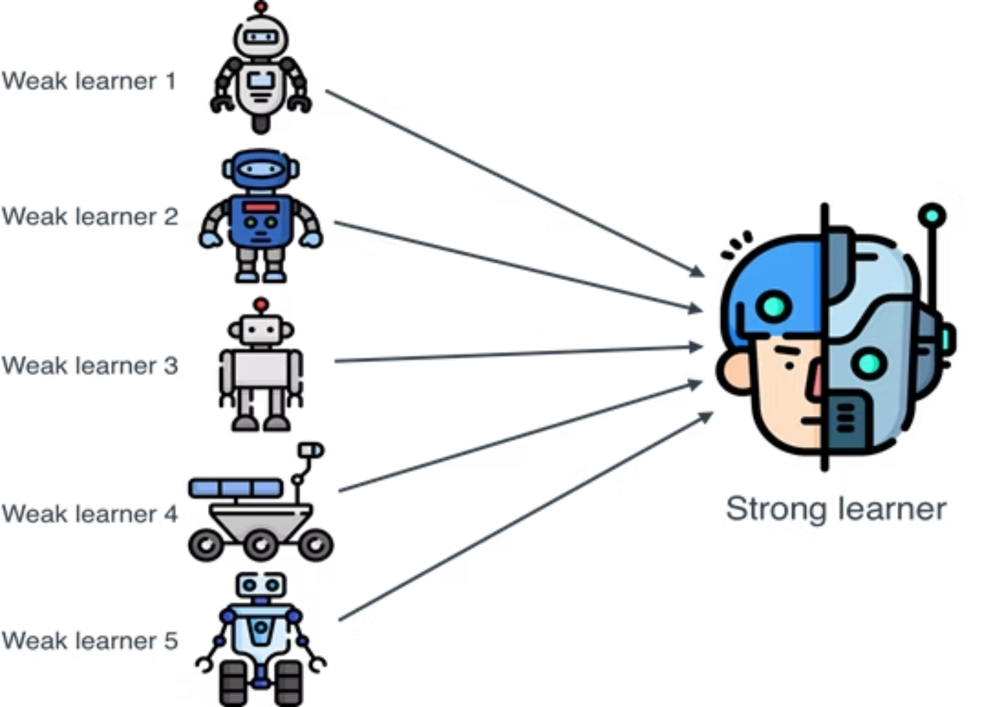
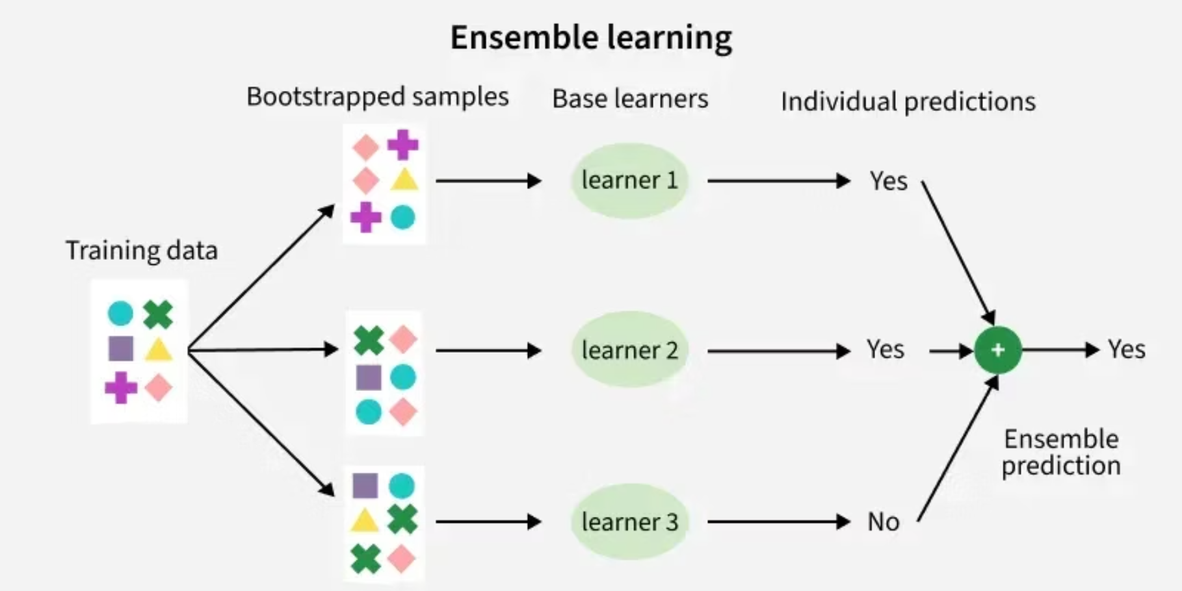
Ensemble Methods Examples
Example: Boosting approach
Example: Bagging approach

Slide 8




How Ensembles Combine Models
Classification Tasks
Regression Tasks
For classification problems, ensembles use majority voting. Each model casts a vote for a class, and the class with the most votes becomes the final prediction.
For regression problems, ensembles use averaging. The predicted values from all models are averaged to produce the final continuous output.
For example, if 7 out of 10 trees predict "spam" and 3 predict "not spam," the ensemble outputs "spam."
If three trees predict house prices of $310K, $295K, and $305K, the ensemble predicts approximately $303K.
Multiple Base Models
Individual Predictions
Aggregation Method
Final Prediction

Slide 9



Why Ensembles Are Effective
Diverse Perspectives
Errors Cancel Out
Increased Stability
Different models make different mistakes because they learn different patterns. One tree might overfit to certain features while another captures different relationships in the data.
When predictions are combined, individual errors often offset each other. If one model overestimates and another underestimates, averaging brings the prediction closer to the true value.
The high variance problem of individual trees is dramatically reduced. The ensemble becomes more robust and reliable, producing consistent predictions even when training data changes slightly.
"The whole is greater than the sum of its parts—ensembles transform unstable decision trees into powerful, reliable predictive models."

